Slide 1
Introducing InnerSource Learning Path and its Translation
InnerSource Commons APAC 2020 Virtual Summit
Russell Rutledge, Nike
Yoshitake Kobayashi, Toshiba
December 2 - 3, 2020

Slide 2


Introduction to InnerSource
Development in silos
Collaborative development with InnerSource
Notes:
Russ

Slide 3
Issues to start InnerSource
For Executives, Managers and Product owners
Difficult to understand what is InnerSource
Difficult to understand actual benefits and how to get them
For developers
Not familiar with running an open project
How to mentor others
How to ensure good design
Collaborative decision making
Different motivations and context than open source
Time deadlines
Interest mainly comes from unblocking rather than contributing
Notes:
Set up why we need the learning path
Russ

Slide 4
Introducing to the InnerSource Learning Path
Series of training segments
Individual segments are grouped by common themes into sections
Introduction
Trusted Committer
Contributor
Product Owner
Community Collaboration
Produced via the InnerSource Commons community.
Track each tasks and discuss their status openly using a GitHub project and Kanban board.
Notes:
What is the the learning path
Russ

Slide 5
Why do we need translations?
Better to read or to understand the contents
Easier to get more intention from non-English speaker

Slide 6
Why did I start translation?
My motivation and goal
Want to change software development culture (in company and also in Japan)
Backgrounds
My colleagues were not motivated for the InnerSource
They don’t know what is the InnerSource
They don’t know what the Open Source development
They don’t believe in the benefit of the InnerSource, yet
The language barrier makes these people unmotivated
Requirement
Need a good reference document in native language to explain what I say

Slide 7
How the translation works?
All translation work is done on GitHub
https://github.com/InnerSourceCommons/InnerSourceLearningPath
Requires review from a native speaker and a community member
Require at least two persons to start translation for each language
Translator
Reviewer
Committer
Translate
Review
Merge
Pull request
LGTM
Fixes / Comments

Slide 8
How to start translation?
Fork the InnerSourceLearningPath repository to your GitHub account
Read the README.md and the CONTRIBUTING.md
Create a subfolder in each section with two-character language code
Translate articles
Commit your changes
Send a pull request to InnerSourceCommons/InnerSourceLearningPath
Ask reviewer (or reviewer candidates) for review
Publish to the Internet

Slide 9
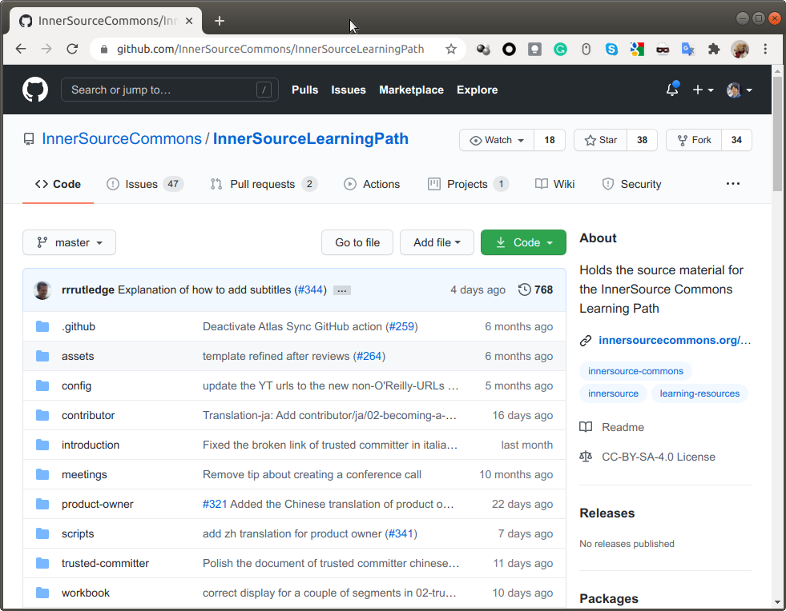
How to start translation?
Fork the InnerSourceLearningPath repository to your GitHub account
Read the README.md and the CONTRIBUTING.md
Create a subfolder in each section with two-character language code
Translate articles
Commit your changes
Send a pull request to InnerSourceCommons/InnerSourceLearningPath
Ask reviewer (or reviewer candidates) for review
Publish to the Internet
Fork to your account

Slide 10
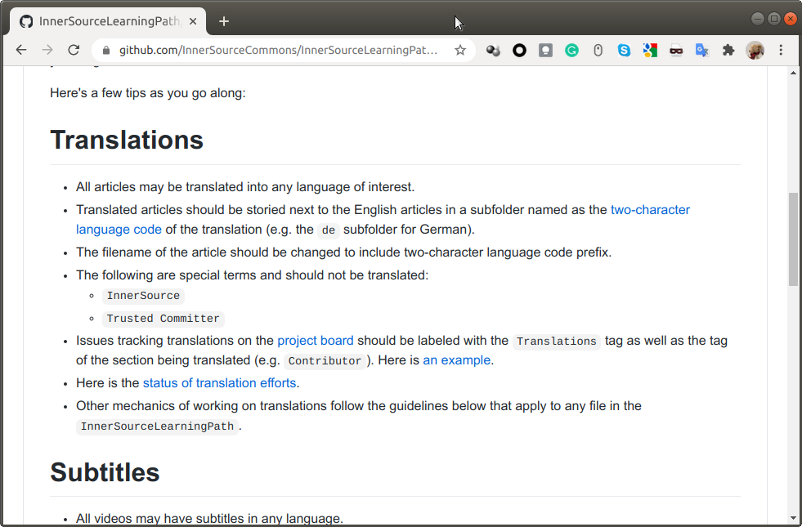
How to start translation?
Fork the InnerSourceLearningPath repository to your GitHub account
Read the README.md and the CONTRIBUTING.md
Create a subfolder in each section with two-character language code
Translate articles
Commit your changes
Send a pull request to InnerSourceCommons/InnerSourceLearningPath
Ask reviewer (or reviewer candidates) for review
Publish to the Internet
Instruction for translations
Ref: https://github.com/InnerSourceCommons/InnerSourceLearningPath/blob/master/CONTRIBUTING.md

Slide 11
How to start translation?
Fork the InnerSourceLearningPath repository to your GitHub account
Read the README.md and the CONTRIBUTING.md
Create a subfolder in each section with two-character language code
Translate articles
Commit your changes
Send a pull request to InnerSourceCommons/InnerSourceLearningPath
Ask reviewer (or reviewer candidates) for review
Publish to the Internet
Translated articles stored in two-character language code subfolder
The filename for translated article includes two-character language code
InnerSourceLearningPath
introduction
de
Subfolder for German translation
it
Subfolder for Italian translation
ja
Subfolder for Japanese translation
01-introduction-ja.asciidoc
Japanese translation
zh
Subfolder for Chinese translation
01-introduction.asciidoc
Original article

Slide 12
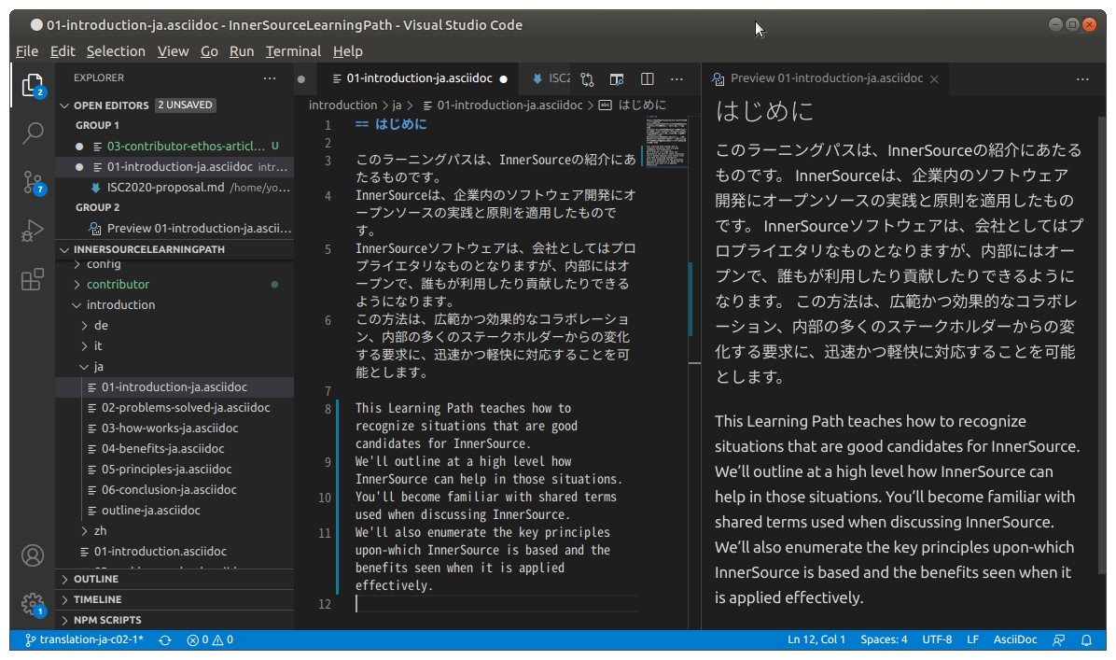
How to start translation?
Fork the InnerSourceLearningPath repository to your GitHub account
Read the README.md and the CONTRIBUTING.md
Create a subfolder in each section with two-character language code
Translate articles
Commit your changes
Send a pull request to InnerSourceCommons/InnerSourceLearningPath
Ask reviewer (or reviewer candidates) for review
Publish to the Internet
The following are special terms and should not be translated:
InnerSource
Trusted Committer

Slide 13
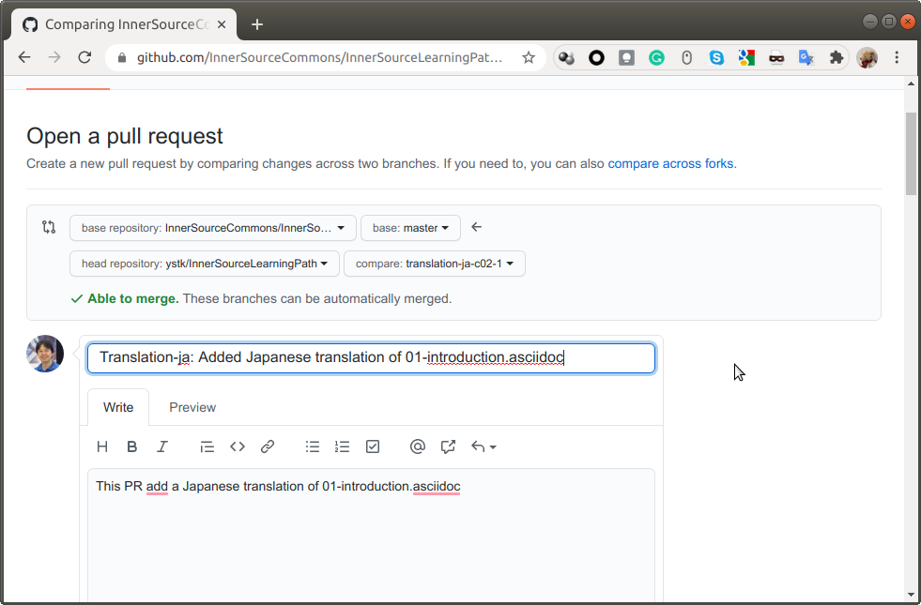
How to start translation?
Fork the InnerSourceLearningPath repository to your GitHub account
Read the README.md and the CONTRIBUTING.md
Create a subfolder in each section with two-character language code
Translate articles
Commit your changes
Send a pull request to InnerSourceCommons/InnerSourceLearningPath
Ask reviewer (or reviewer candidates) for review
Publish to the Internet

Slide 14
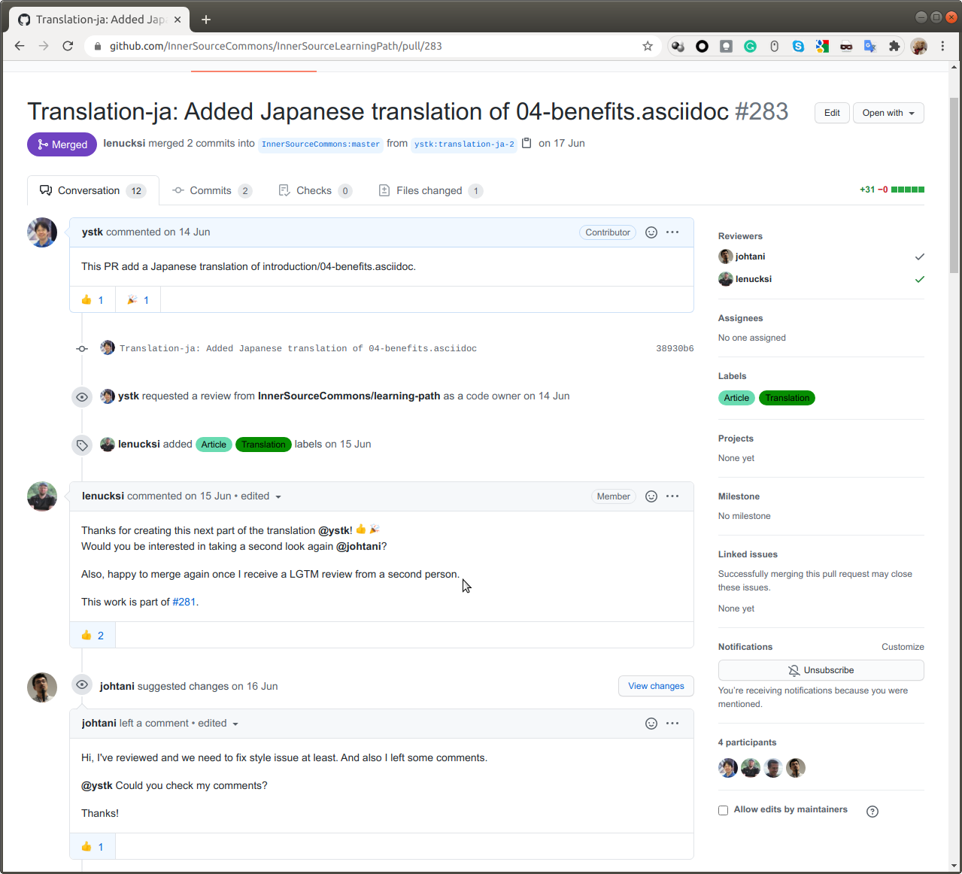
How to start translation?
Fork the InnerSourceLearningPath repository to your GitHub account
Read the README.md and the CONTRIBUTING.md
Create a subfolder in each section with two-character language code
Translate articles
Commit your changes
Send a pull request to InnerSourceCommons/InnerSourceLearningPath
Ask reviewer (or reviewer candidates) for review
Publish to the Internet

Slide 15
How to start translation?
Fork the InnerSourceLearningPath repository to your GitHub account
Read the README.md and the CONTRIBUTING.md
Create a subfolder in each section with two-character language code
Translate articles
Commit your changes
Send a pull request to InnerSourceCommons/InnerSourceLearningPath
Ask reviewer (or reviewer candidates) for review
Publish to the Internet

Slide 16
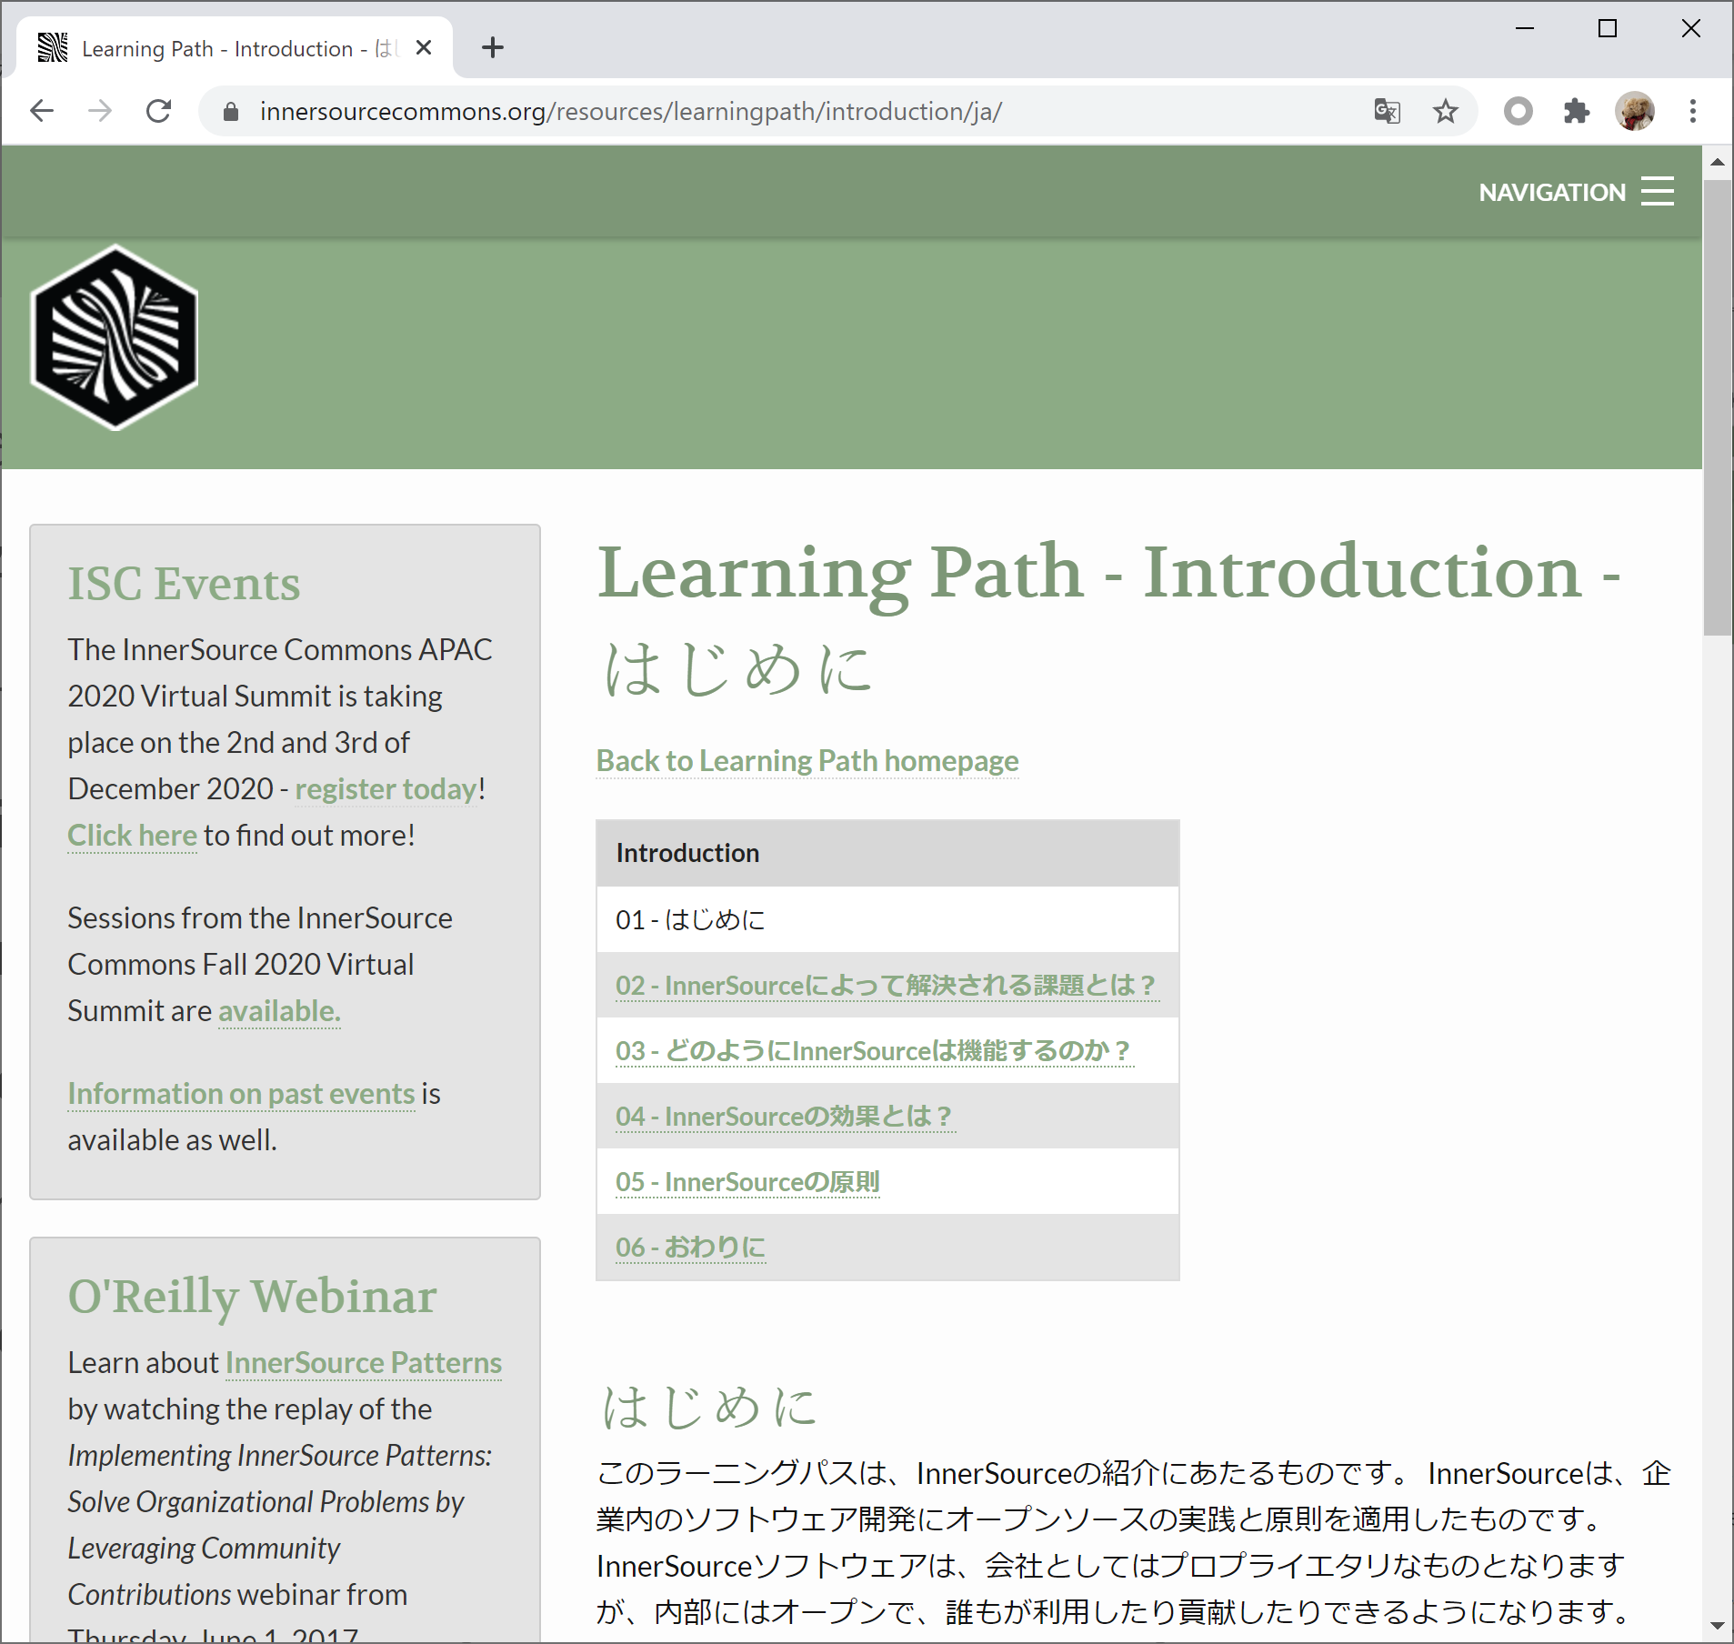
How to start translation?
Fork the InnerSourceLearningPath repository to your GitHub account
Read the README.md and the CONTRIBUTING.md
Create a subfolder in each section with two-character language code
Translate articles
Commit your changes
Send a pull request to InnerSourceCommons/InnerSourceLearningPath
Ask reviewer (or reviewer candidates) for review
Publish to the Internet

Slide 17
Status of translation efforts
Sections
Language | Introduction | Trusted Committer | Product Owner | Contributor
German | X | X
Chinese | X | X | X | X
Japanese | X |  |  | /
Italian | X
Your language here
X: signifies all translations done.
/ : signifies some translations done.

Slide 18
How to get involved
Join the InnerSource Commons slack channel
http://isc-inviter.herokuapp.com/
Show your interest at the #learning-path channel
Any contributions are very welcome!

Slide 19
Please join and let’s work together!

